Slide 1
SERVICES & INFRASTRUCTURE
Print Services
Designing and Creative services
All kind of Digital / Offset Printing & Finishing Jobs required by Corporates
End – to – End solution with the distribution of Documents
Digitization Services
Scanning, Indexing and Conversion in various File Formats
DMS as Cloud service (Data Centre )
Infrastructure
High Speed Color Machine | 1
High Speed Mono Machine | 1
LFP | 2
Finishing Equipment - Cutting, Binding, Lamination… | 1 each
Lab Technical | 1
Partnerships | 3
Digitization | -
Desktops, Servers and LAN | -

Slide 2
BUSINESS MODEL- PRINT CENTER
Organisations
Print Center
Machines/Infrastructure
Scanning
Printing
Copying
+
Workforce
Sales Force

Slide 3
BUSINESS MODEL – APP SERVICE
Students
Application
CAT
IIT-JEE
CPMT
IAS
AIEEE
BANK PO
RAILWAYS
NDA
Coaching Institutions

Slide 4
BUSINESS MODEL - CABS
180
CABS
cabs owned
+
Call Center Employees
10
Customer Service
Representatives
Drivers
Rs 1,850
of daily collection

Slide 5
TIMELINES FOR BUSINESS HISTORY
HISTORICAL PERFORMANCE
Started Delivering IT Solutions
Won a large mobile app project
Patented apps in healthcare
Offshore delivery center in India
Graph not accurately scaled to time
2007-09
2010
2011
2012
2013
2014
Started office Chicago
Mobile gaming applications
Ventured into animation
i- app
Launching Early Jan 14

Slide 6
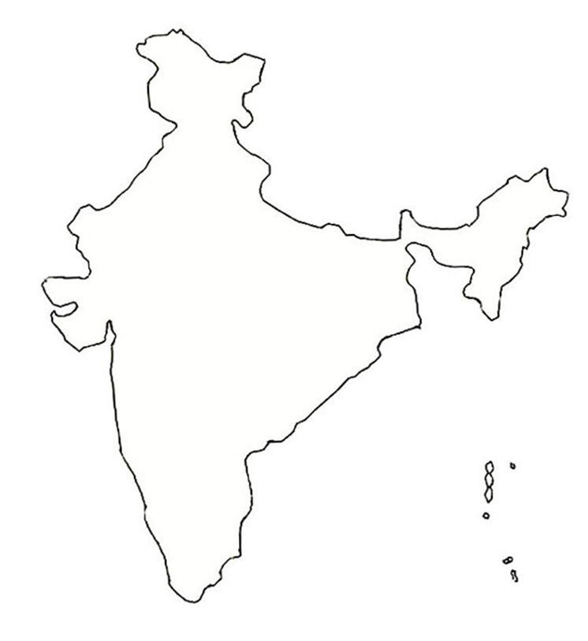
POINTING OUT LOCATIONS
Delhi
Mumbai
Bangalore

