Slide 1
5 Classic Animation Styles
for stunning presentations

Slide 2
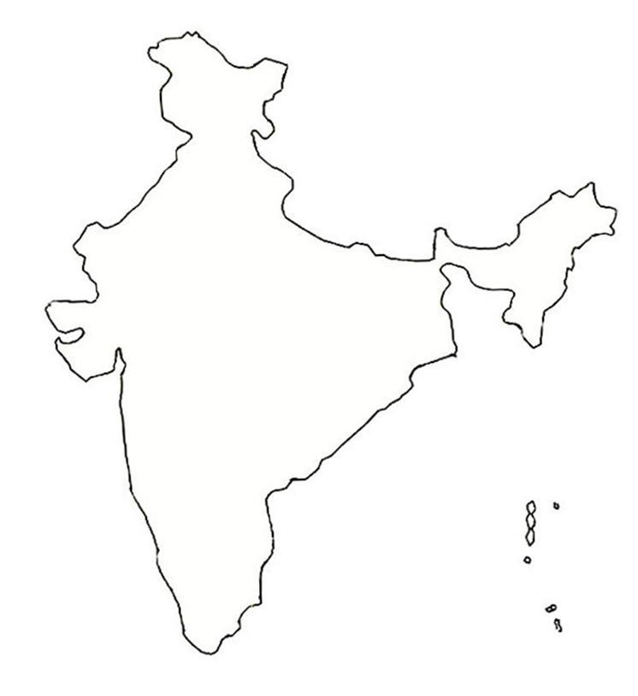
POINTING OUT LOCATIONS ON A MAP
Delhi
Mumbai
Bangalore

Slide 3
POINTING OUT LOCATIONS ON A MAP
Delhi
Mumbai
Bangalore

